Slide 1

Data Scientist Salary Analysis
Analyzing Salary Trends and Building Predictive Models
BY GROUP 36

Slide 2
Objectives and Dataset Overview
Objectives:
Explore salary trends and influential factors.
Visualize patterns in the data using dimensionality reduction and clustering.
Train predictive models and improve their performance.
Dataset:
742 job postings with 42 features.
Key variables: Job Title, Avg Salary(K), Skills, Company Details.

Slide 3
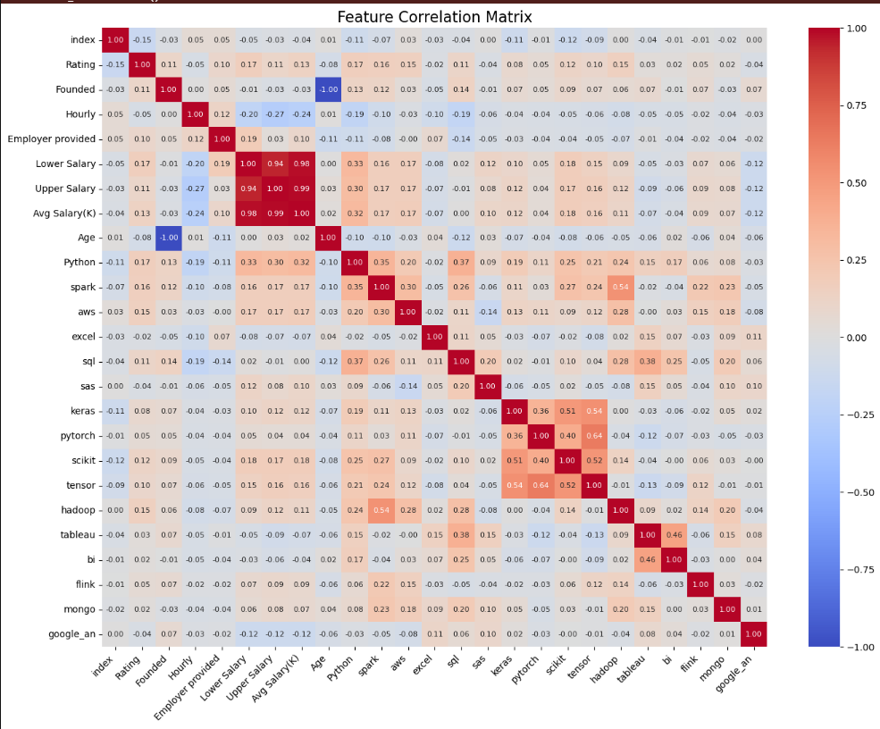
Data Cleaning and Correlation Analysis
  Key Steps:
    Replaced missing values and computed Avg Salary(K).
    Analyzed feature correlations to uncover relationships
  Graph:
      Correlation Heatmap

Slide 4
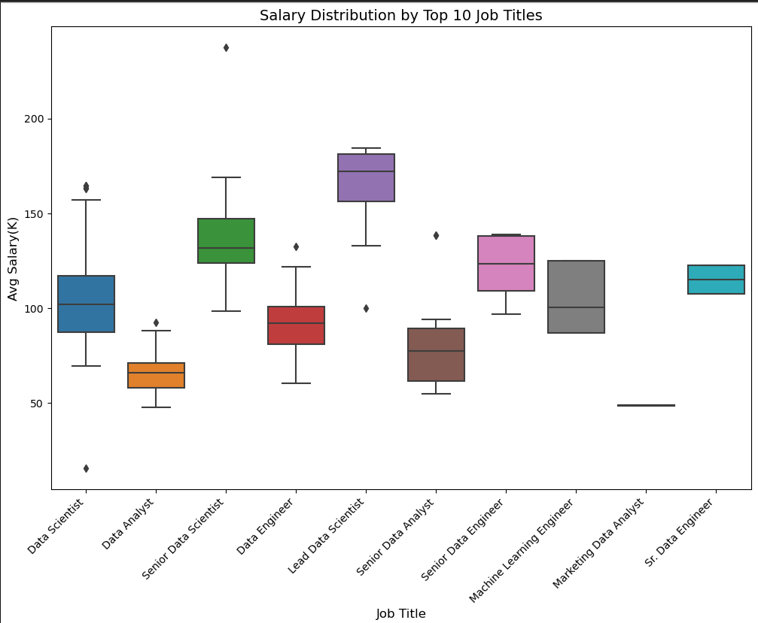
Salary Distribution by Job Title
  Insight:
    Specialized roles, such as Senior Data Scientist, have higher median salaries.
  Graph:
  Box Plot for Top 10 Job Titles

Slide 5
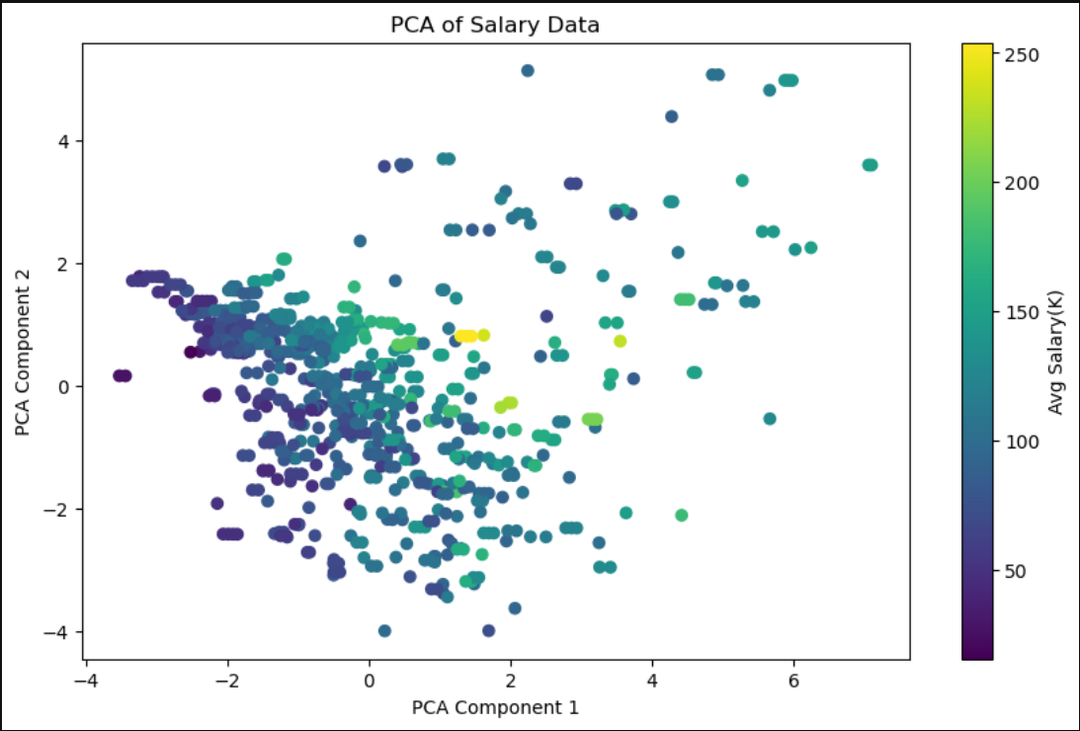
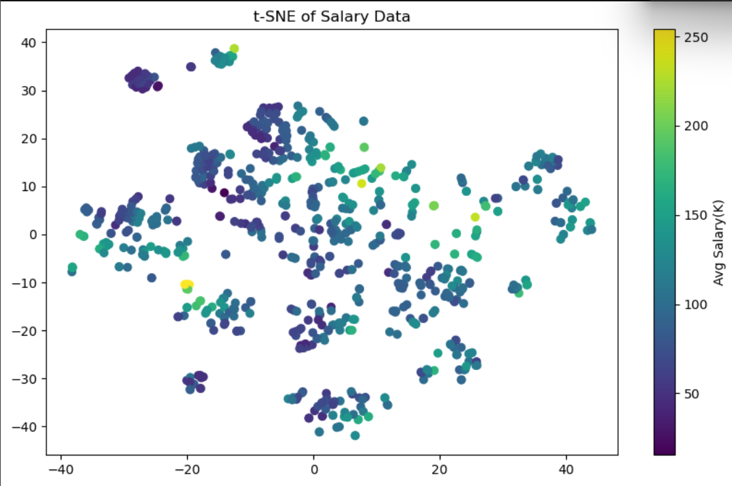
Dimensionality Reduction
Techniques:
PCA to reduce dimensionality while retaining variance.
t-SNE for visualizing relationships in a 2D space.

Slide 6
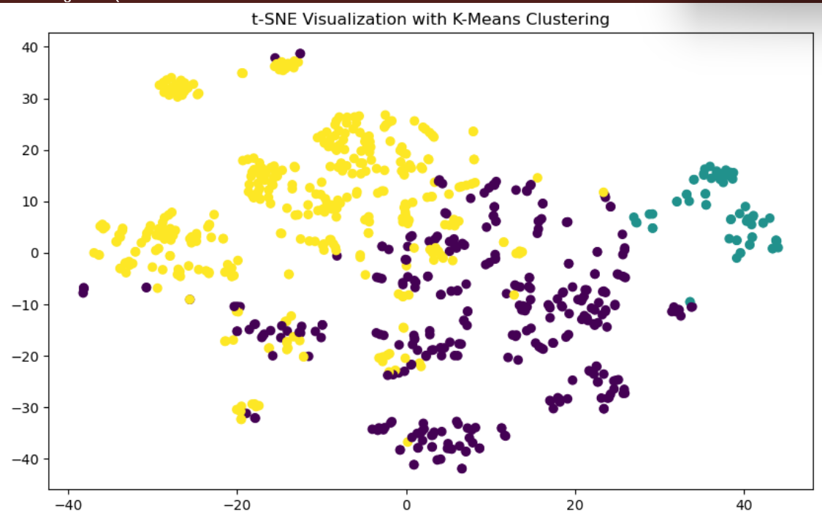
Clustering
  Result:
    K-means clustering segmented the data into three groups.
  Graph:
  t-SNE Visualization with K-Means Clustering

Slide 7
Predictive Modeling
Models:
Linear Regression (baseline)
Improved models: Lasso, Ridge, Gradient Boosting.
Performance:
Gradient Boosting achieved the highest R² of 0.88.

Slide 8
Insights and Recommendations
Insights:
Specialized roles, such as Senior Data Scientist, command higher salaries.
Skills like Python, SQL, and AWS are consistently in demand.
Larger companies offer competitive salaries.
Recommendations:
For job seekers: Focus on acquiring in-demand technical skills and targeting specialized roles.
For employers: Highlight high-paying roles to attract top talent.

Slide 9

Conclusion
  Summary:
    Objectives achieved: Explored trends, visualized data, and built predictive models.
    Gradient Boosting achieved the best predictive performance.

